Slide 1


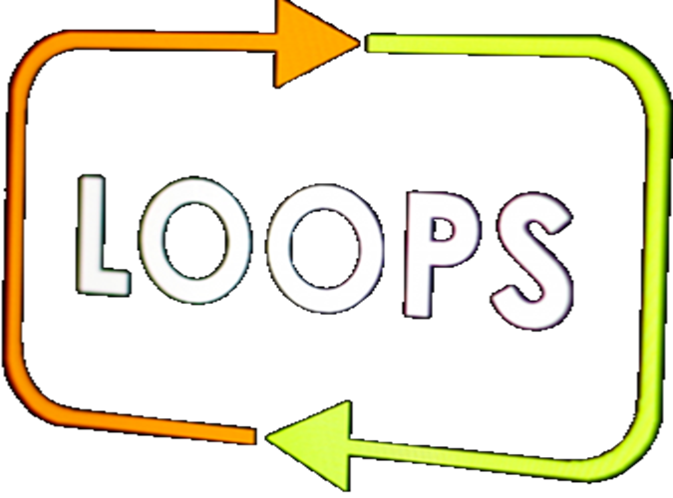

Repetitions (cycles)
Repetitions with for-cycle
Повторения
SoftUni Team
Technical Trainers
Software University
http://softuni.bg

Slide 2
Questions?
sli.do 123321

Slide 3

Content
Increment and decrement operators
For-cycle
Construction

Slide 4

Content (2)
Advanced loop constructions:
Loop with a step
Loop with a negative step
Cycle - while
Cycle - do-while
Endless loop
Operator break
Operator continue

Slide 5

Increment and Decrement operators

Slide 6
Increment
Increment – add 1 to the value of a number
You have to use an operator as a – prefix or postfix
It is applied only on variables which have numerical value
Пример | Име | Резултат
++a | Пре-инкрементация | Увеличава стойността с единица и връща "а"
а++ | Пост-инкрементация | Връща "а" и увеличава стойността с единица

Slide 7

Increment (2)
Prefix
Postfix
int a = 1;
Console.WriteLine(++a);
Console.WriteLine(a);
// 2
// 2
int a = 1;
Console.WriteLine(a++);
Console.WriteLine(a);
// 1
// 2

Slide 8
Decrement
Decrement – subtract 1 from the value of a number
You have to use an operator as a – prefix or postfix
It is applied only on variables which have numerical value
Пример | Име | Резултат
--a | Пре-декрементация | Намалява стойността с единица и връща "а"
а-- | Пост-декрементация | Връща "а" и намалява стойността с единица

Slide 9
Decrement (2)
Prefix
Postfix
int a = 1;
Console.WriteLine(--a);
Console.WriteLine(a);
// 0
// 0
int a = 1;
Console.WriteLine(a--);
Console.WriteLine(a);
// 1
// 0

Slide 10
Repeating a block of code
for-cycle construction

Slide 11
Repetitions (cycle) – for-cycle
In programming we often need to repeat a block of code mode than once
That is why we use cycles
Keyword
Initial value
Final value
for (var i = 1; i <= 10; i++)
{
Console.WriteLine("i = " + i);
}
Increment of the iterator (i)
Body: block of code
(for repetition)

Slide 12
Numbers from 1 to 100
Write a program which:
Prints the numbers in range [1, 100], every on a new line
Solution:
for (int i = 1; i <= 100; i++)
{
Console.WriteLine(i);
}
Test your solution: https://judge.softuni.bg/Contests/Compete/Index/859#18

Slide 13
Numbers to 1000, Ending in 7
Write a program which:
Prints the numbers in range [1, 1000], which end in 7
Solution:
for (int i = 0; i <= 1000; i++)
{
if (i % 10 == 7)
{
Console.WriteLine(i);
}
}
Test your solution: https://judge.softuni.bg/Contests/Compete/Index/859#19

Slide 14
Sum Numbers – example
Write a program which:
Reads an integer (n) from the console
Reads (n) consecutive numbers from the console and sums them
Print the sum of all numbers
Example Input/Output:
2
10
20
30
3
-10
-20
-30
-60
4
45
-20
7
11
43

Slide 15
Sum Numbers – solution
var n = int.Parse(Console.ReadLine());
var sum = 0;
for (var i = 0; i < n; i++)
{
var num = int.Parse(Console.ReadLine());
sum = sum + num;
}
Console.WriteLine("sum = " + sum);
We can read numbers in a loop
// sum += num
Test your solution: https://judge.softuni.bg/Contests/Compete/Index/859#20

Slide 16
Max number – example
Write a program which:
Reads an integer (n) from the console
Reads (n) consecutive numbers from the console
Finds the biggest amongst them
Example Input/Output:
4
45
-20
7
99
99
3
-10
20
-30
20
2
100
99
100

Slide 17
Max Number – solution
var n = int.Parse(Console.ReadLine());
var max = int.MinValue;
for (var i = 1; i <= n; i++)
{
var num = int.Parse(Console.ReadLine());
if (num > max)
max = num;
}
Console.WriteLine("max = " + max);
Test your solution: https://judge.softuni.bg/Contests/Compete/Index/859#21

Slide 18
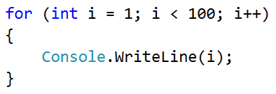
Repetitions of a block of code
Work live in class (lab)

Slide 19



Exercises with loops
for-loops
Ways to use a for-cycle

Slide 20
Left and Right Sum – example
Write a program which:
Reads an integer (n) from the console
Reads consecutive 2*(n) numbers
Checks if the sum of the left (n) and the right (n) are equal
If they are than print "Yes" and the sum, in case they are not - "No" and the difference (calculated as a positive number)

Slide 21
Left and Right Sum – example (2)
Example Input/Output:
2
10
90
60
40
Yes, sum = 100
2
90
9
50
50
No, diff = 1

Slide 22
Left and Right Sum – solution
var n = int.Parse(Console.ReadLine());
var leftSum = 0;
for (var i = 0; i < n; i++)
leftSum = leftSum + int.Parse(Console.ReadLine());
// TODO: read and calculate the rightSum
if (leftSum == rightSum)
Console.WriteLine("Yes, sum = " + leftSum);
else
Console.WriteLine("No, diff = " +
Math.Abs(rightSum - leftSum));
Test your solution: https://judge.softuni.bg/Contests/Compete/Index/859#22

Slide 23


Loops with a step
Working with advanced loops

Slide 24
Numbers from 1 to N with Step 3 – example
Write a program which:
Reads an integer n
Prints the numbers from 1 to n with step 3
Example Input/Output:
10
1, 4, 7, 10
15
1, 4, 7, 10, 13

Slide 25
Numbers from 1 to N with Step 3 – solution
var n = int.Parse(Console.ReadLine());
for (var i = 1; i <= n; i+=3)
{
Console.WriteLine(i);
}
We change the step
Test your solution: https://judge.softuni.bg/Contests/Compete/Index/859#23

Slide 26
Numbers from N to 1 – example
Write a program which:
Reads an integer n
Prints the numbers from n to 1 (step -1)
Example Input/Output:
100
100, 99, 98, …, 3, 2, 1
3
3, 2, 1

Slide 27

Numbers from N to 1 – solution
var n = int.Parse(Console.ReadLine());
for (var i = n; i >= 1; i-=1)
{
Console.WriteLine(i);
}
Negative step: -1
Fixed condition: i >= 1
Test your solution: https://judge.softuni.bg/Contests/Compete/Index/859#24

Slide 28
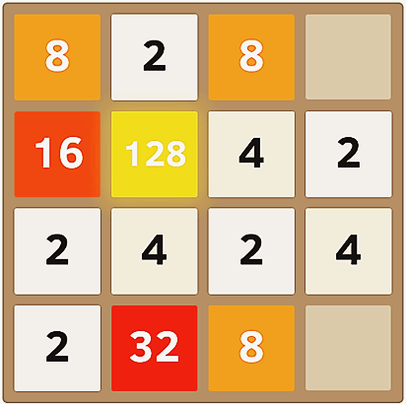
Numbers from 2^0 to 2^N – example
Write a program which:
Reads an integer n
Prints the numbers from 1 to 2^{n}
Example Input/Output:
10
1, 2, 4, 8, 16, 32, …, 1024
5
1, 2, 4, 8, 16, 32

Slide 29
Numbers from 2^0 to 2^N – solution
var n = int.Parse(Console.ReadLine());
var num = 1;
for (var i = 0; i <= n; i++)
{
Console.WriteLine(num);
num = num * 2;
}
Test your solution: https://judge.softuni.bg/Contests/Compete/Index/859#25

Slide 30

While loop
false
condition
true
while
commands
Repeats a block while a conditions is true

Slide 31
While cycle
The body of the cycle repeats until the condition is true
Condition (true/false)
while (...)
{
//code
}
Code to execute (repeat)

Slide 32
Sequence 2k + 1 – example
Write a program which:
Reads an integer n
Prints all numbers ≤ n in a sequence: 1, 3, 7, 15, 31, …
Every next number is equal to the previous * 2 + 1
1, (1*2)+1 = 3, (3*2)+1 = 7, (7*2)+1 = 15 …

Slide 33
Sequence 2k + 1 – solution
var n = int.Parse(Console.ReadLine());
var num = 1;
while (num <= n)
{
Console.WriteLine(num);
num = 2 * num + 1;
}
Repeats while num ≤ n is true
1, 3, 7, 15, 31, 63, …
Test your solution: https://judge.softuni.bg/Contests/Compete/Index/859#26

Slide 34
Do…While cycle
commands
do-while
true
false
condition
Repeats a block while a conditions is true

Slide 35
Do-while cycle
The body of the cycle repeats until the condition is true
Executes at least once
Code for execution (repetition)
do
{
//code
} while (...);
Condition (true/false)

Slide 36
Factorial – example
Write a program which:
Reads an integer n
Calculates the factorial of n (n!)
Example Input/Output:
5! = 1 * 2 * 3 * 4 * 5 = 120
n!
5
120

Slide 37
Factorial – solution
var n = int.Parse(Console.ReadLine());
var fact = 1;
do
{
fact = fact * n;
n--;
} while (n > 1);
Console.WriteLine(fact);
n!
Test your solution: https://judge.softuni.bg/Contests/Compete/Index/859#27

Slide 38
Sum Digits of a Number – example
Write a program which:
Reads an integer n
Sums the digits of n
Example Input/Output:
n = 5634: 5 + 6 + 3 + 4 = 18
5634
18
1234
10

Slide 39
Sum Digits of a Number
var n = int.Parse(Console.ReadLine());
var sum = 0;
do
{
sum = sum + (n % 10);
n = n / 10;
} while (n > 0);
Console.WriteLine("Sum of digits: {0}", sum);
n % 10 returns the last digit of n
n / 10 removes the last digit of n
Test your solution: https://judge.softuni.bg/Contests/Compete/Index/859#28

Slide 40


Infinite loops and break и continue
break
break
endless cycle

Slide 41


Infinite loop
We have an infinite loop when:
We don’t have a condition which breaks the loop
We don’t have a statement which terminates the loop
while(true){
Console.WriteLine("Infinite loop");
}
for (;;){
Console.WriteLine("Infinite loop");
}

Slide 42
Conditions for terminating a loop
Condition for terminating a loop
while(...)
{
Console.WriteLine("Infinite loop");
}
Condition for terminating a loop
for (;...;)
{
Console.WriteLine("Infinite loop");
}

Slide 43
Statement for terminating a loop
Statement break – terminates the loop
while(true)
{
Console.WriteLine("Infinite loop");
if (…)
{
break;
}
}
Condition for terminating a loop
Statement for terminating the loop

Slide 44
Summary
We can increment/decrement numerical values
We can repeat a block of code using for-cycle:
int a = 1;
Console.WriteLine(--a); // 0
Console.WriteLine(a++); // 0
Console.WriteLine(a); // 1
for (var i = 1; i <= 10; i++)
{
Console.WriteLine("i = " + i);
}

Slide 45
Summary (2)
We can read (n) numbers from the console:
var n = int.Parse(Console.ReadLine());
for (var i = 0; i < n; i++)
{
var num = int.Parse(Console.ReadLine());
…
}

Slide 46
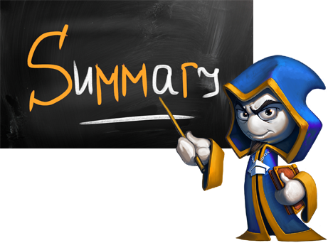
Summary (3)
We can use for-cycles with a step:
Cycles while / do-while repeat a block of code while a condition is true:
for (var i = 1; i <= n; i+=3)
Console.WriteLine(i);
var num = 1;
while (num <= n)
Console.WriteLine(num++);

Slide 47
Summary (4)
We can create infinite loops and terminate them when we need:
for (;;) {
if (…)
break;
}
while (true){
if (…)
break;
}

Slide 48







Repetitions (cycle)
https://softuni.bg/courses/

Slide 49
License
This course (slides, examples, demos, videos, homework, etc.) is licensed under the "Creative Commons Attribution-NonCommercial-ShareAlike 4.0 International" license

Slide 50





Trainings @ Software University (SoftUni)
Software University – High-Quality Education, Profession and Job for Software Developers
softuni.bg
Software University Foundation
http://softuni.foundation/
Software University @ Facebook
facebook.com/SoftwareUniversity
Software University Forums
forum.softuni.bg

